Slide 1
Renewable Carbon
Concept and Initiative
&
CCU
Michael Carus (CEO)
nova-Institute

Slide 2
Your partner in strategy, technology
and sustainability
SCIENCE-BASED CONSULTANCY
ON RENEWABLE CARBON
FOR CHEMICALS AND
MATERIALS
We support your
smart transition to
renewable carbon
nova-Institute was founded
in 1994 and has a multidisciplinary
and international team of more
than 40 scientists
Get to know our experts at:
nova-institute.eu/nova-team

Slide 3



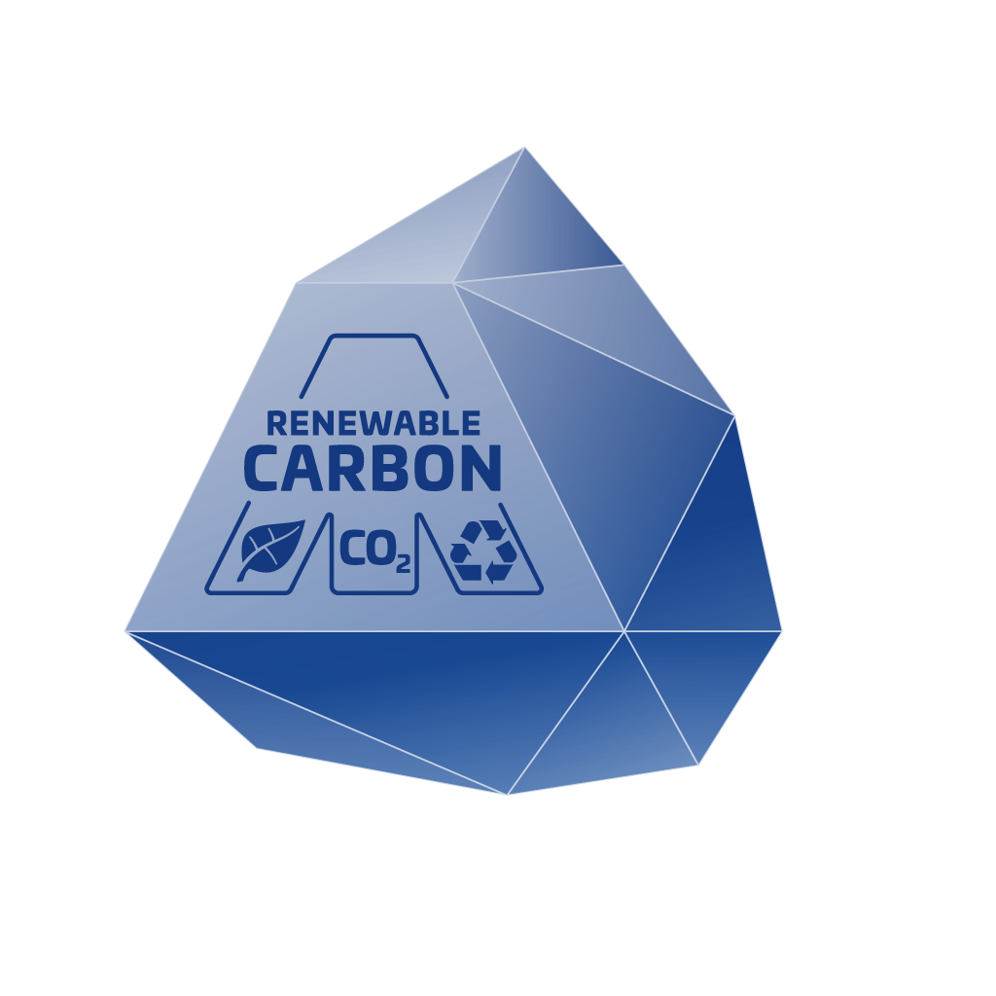
nova-Institut GmbH – SME
private and independent research institute
interdisciplinary, international team
Communication
Comprehensive Communication
& Dissemination in Research Projects
Communication & Marketing Support
Network of 60,000 Contacts to Companies,
Associations & Institutes
Targeted Newsletters for 17 Specialty Areas
of the Industry
Conferences, Workshops & nova Sessions
In-depth B2C Research
Technology & Markets
Market Research
Innovation & Technology Scouting
Trend & Competitive Analysis
Supply & Demand Analysis
Feasibility & Potential Studies
Customised Expert Workshops
Sustainability
Economy & Policy
Tailor-made Life Cycle Assessments
Customised Carbon Footprint Calculation Tools
Social Impact Assessment & Social Acceptance
Comprehensive Sustainability Assessments
Sustainability Integrated Technology
Development (SUITED)
Critical Reviews
Micro- and Macroeconomics
Techno-Economic Evaluation (TEE) for
Low & High TRL
Target Price Analysis for Feedstock & Products
Strategic Consulting for Industry, Policy & NGO’s
Political Framework, Measures & Instruments
Standards, Certification & Labelling

Slide 4


































Selected Customers from all Industrial Sectors
IKEA of Sweden

Slide 5




























Selected Customers from Chemical Industry

Slide 6




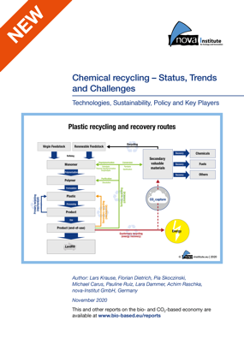
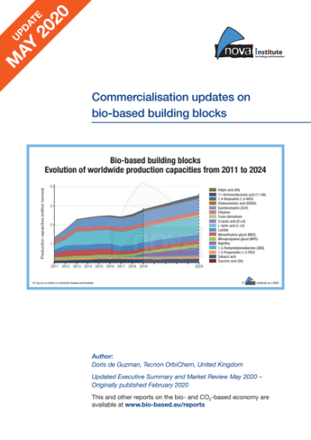

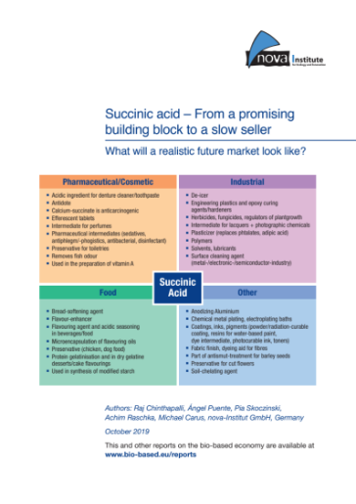



Bio-based Polymers & Building Blocks – the best market reports available
www.renewable-carbon.eu/publications

Slide 7


Major threats and challenges to our planet are
    Climate change and
    Biodiversity loss

Slide 8
Key points of the renewable carbon concept
80% from the GHG emissions are directly related to additional fossil
carbon from the ground.
Climate change is likely to become one of the most significant drivers of biodiversity loss.
Decarbonisation with renewable energies is a good strategy for the energy sector, but no issue for chemicals and materials, because most of them are based on carbon (just like humans ☺).
There is a lasting need for carbon for chemicals and materials. All fossil carbon use has to end, as the carbon contained in the molecules of chemicals and plastics is prone to end up in the atmosphere sooner or later. Only a full phase-out of fossil carbon will help to prevent a further increase in CO₂ concentrations.
The key challenge is to replace demand for fossil carbon by alternative carbon sources.
The equivalent to decarbonisation in the energy sector is a transition to renewable carbon in the chemical and material industries.
Those alternative carbon sources are biomass, CO₂ and recycling of carbon containing waste streams (bio and plastic waste).
We call them “renewable carbon”.
– 8 –

Slide 9
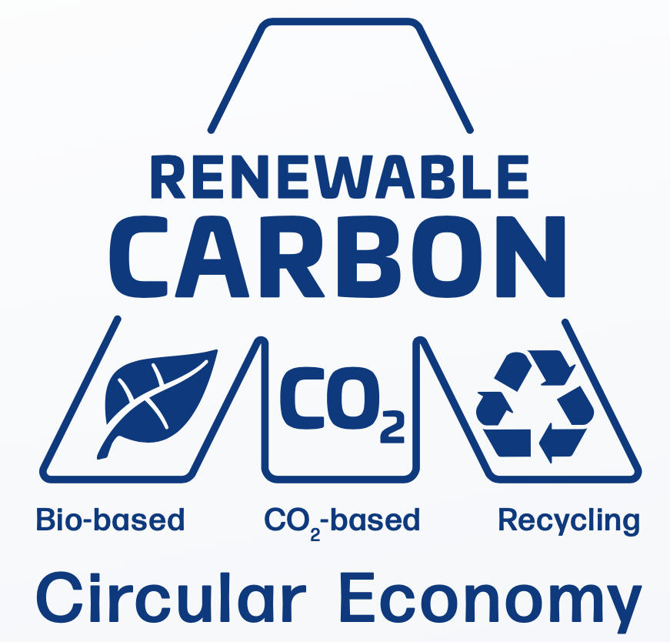
Renewable Carbon is the Key
For the first time since the industrial revolution, technology allows us to decouple the chemical, plastics, fibre and other material industries from the use of fossil carbon.

Slide 10
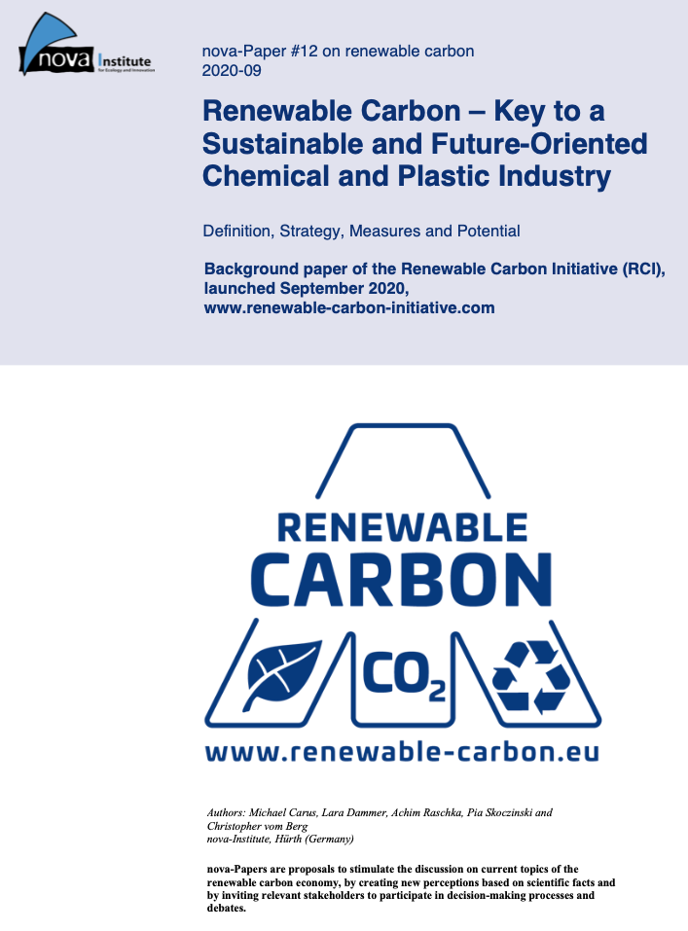

This paper is the background paper of the “Renewable Carbon Initiative (RCI)”, which was published in September 2020.
Free download:
www.renewable-carbon.eu/publications

Slide 11
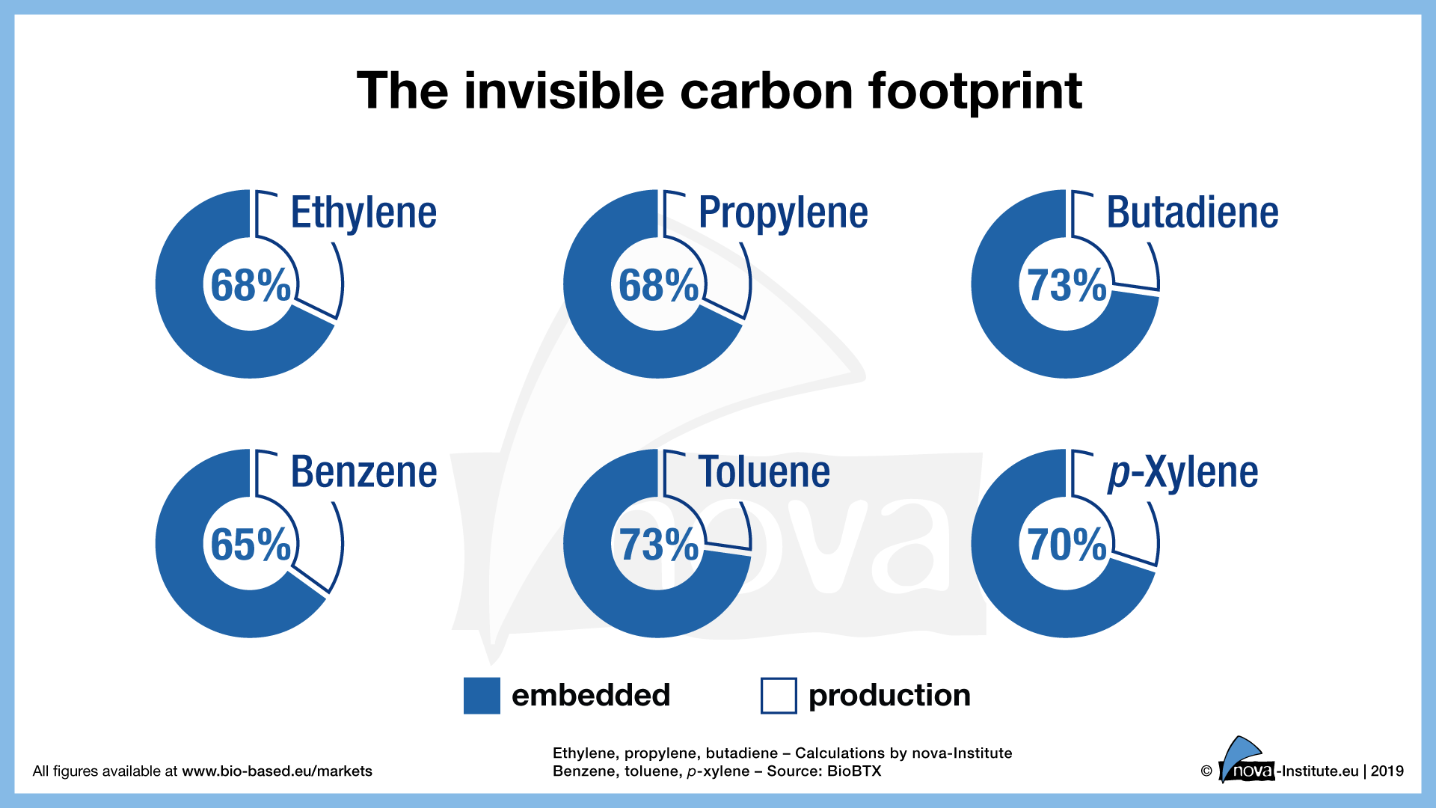

Slide 14
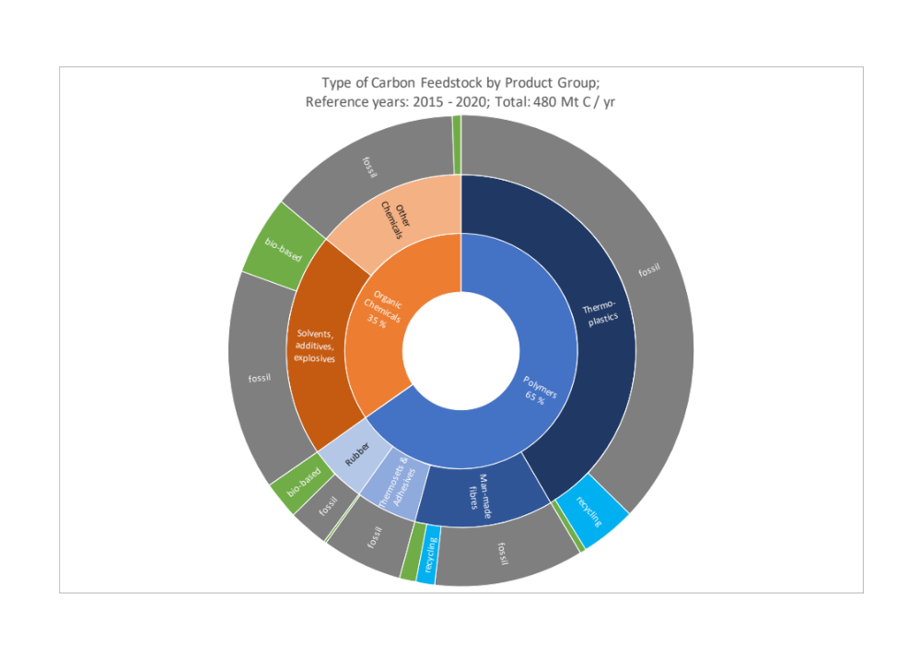
World Carbon demand of the Chemical and Plastic Industry 2015-2020, and shares of fossil, bio-based and recycled carbon
A long way to go renewable!

Slide 15
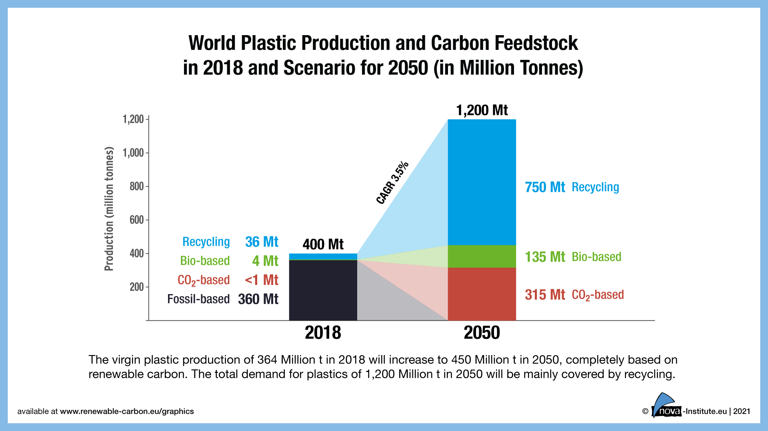
The total of biomass required to do so would amount to roughly 1% of biomass currently used around the globe in all fields of application (13 – 14 billion tonnes, of which 60 per cent alone are attributable to animal feed for the production of milk and meat).
A size of less than 0.5% of the Sahara desert would suffice to cover this 70 per cent by means of photovoltaics and CO₂ utilisation.

Slide 16
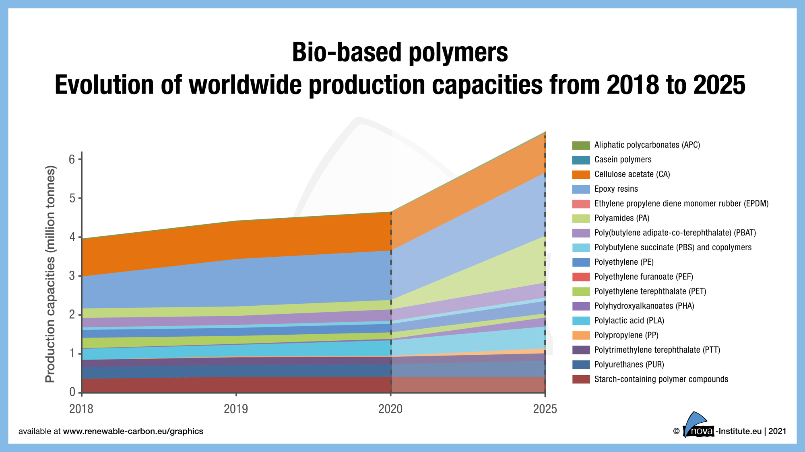

Slide 17
Renewable Carbon from CO₂
Pros in a nutshell
Very high potential in volume (almost unlimited)
Low demand for land and water, low carbon footprint
High TRL technologies available
Almost all chemicals and plastics can be produced from CO₂
High employment potential
Inexhaustible source of carbon for the next millennia
Even “black” CO₂ carbon utilisation lead to relevant GHG reduction
Cons in a nutshell
Potential lock in effects using fossil point sources
Competition on limited renewable electricity
High investment necessary

Slide 18
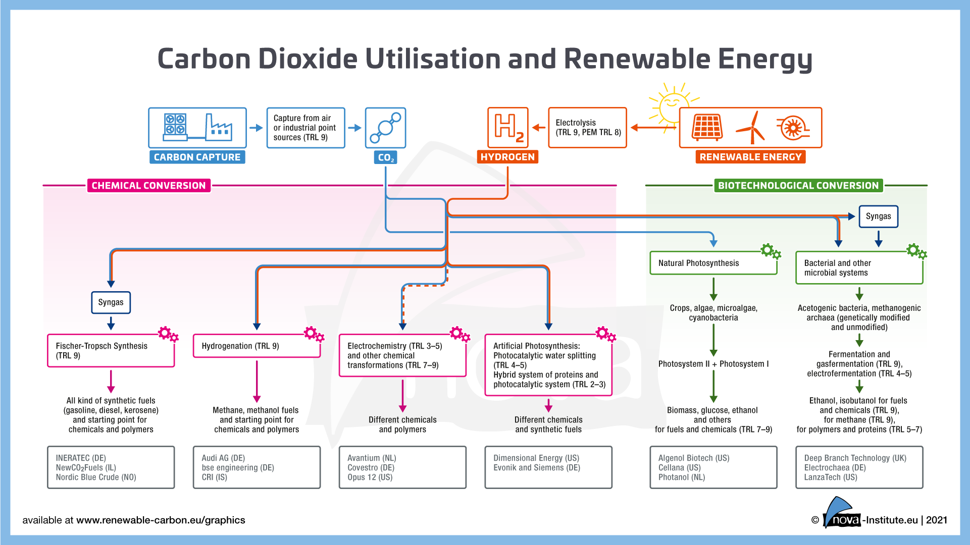

Slide 19
Non-energetic demand from the
Chemical Industry
Different calculation show that a range of 15 to 20 PWh would be required to cover
the entire carbon demand of the chemical industry today by CO₂ utilisation with renewable energy, depending on the efficiency of electrolysis and further processes. For the production of 20 PWh solar power, only 0.9% of the Sahara region is needed for PV.
The PV yield in the Sahara is typically about 250 GWh/km²/y (Breyer 2019, LUT University). That means: To produce 20 PWh from PV an area of 80,000 km² is needed. Compared to the total area of the Sahara of 9,200,000 km² this is only 0.9% of the Sahara region.
The energy won from this area could cover the global non-energetic carbon demand of the chemical and plastics industry as it was in 2018 when applying it to carbon capture and utilisation (CCU) processes.
The total area of deserts is even 30,000,000 km².

Slide 20
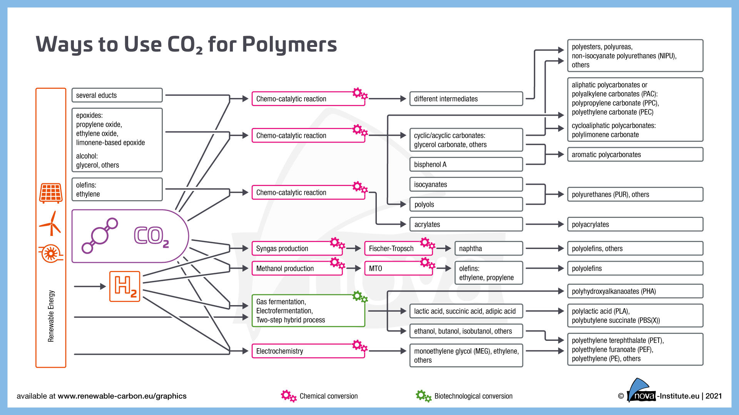


Slide 21
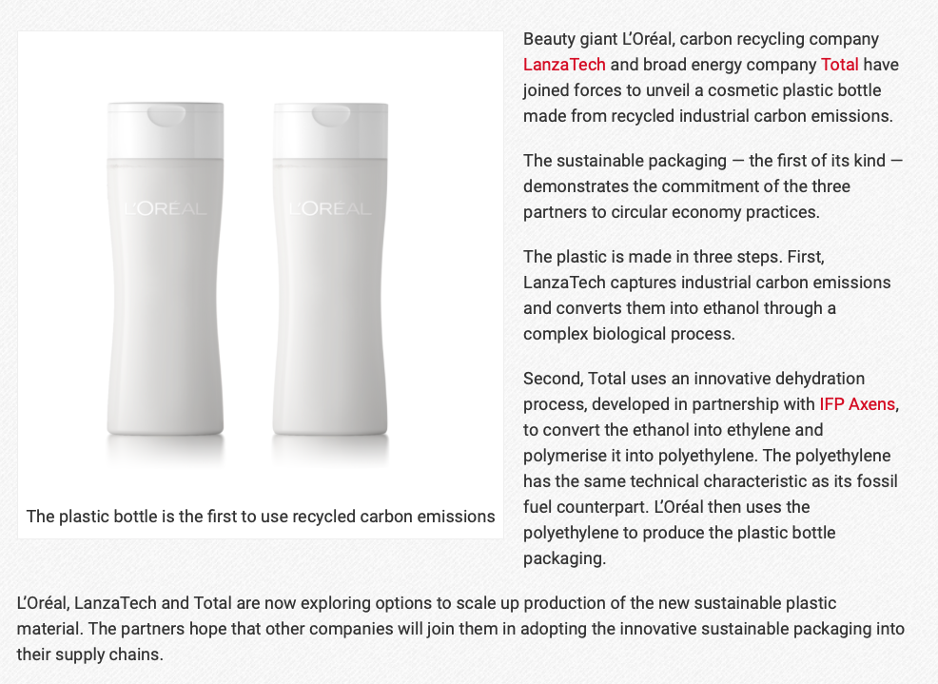

Slide 22
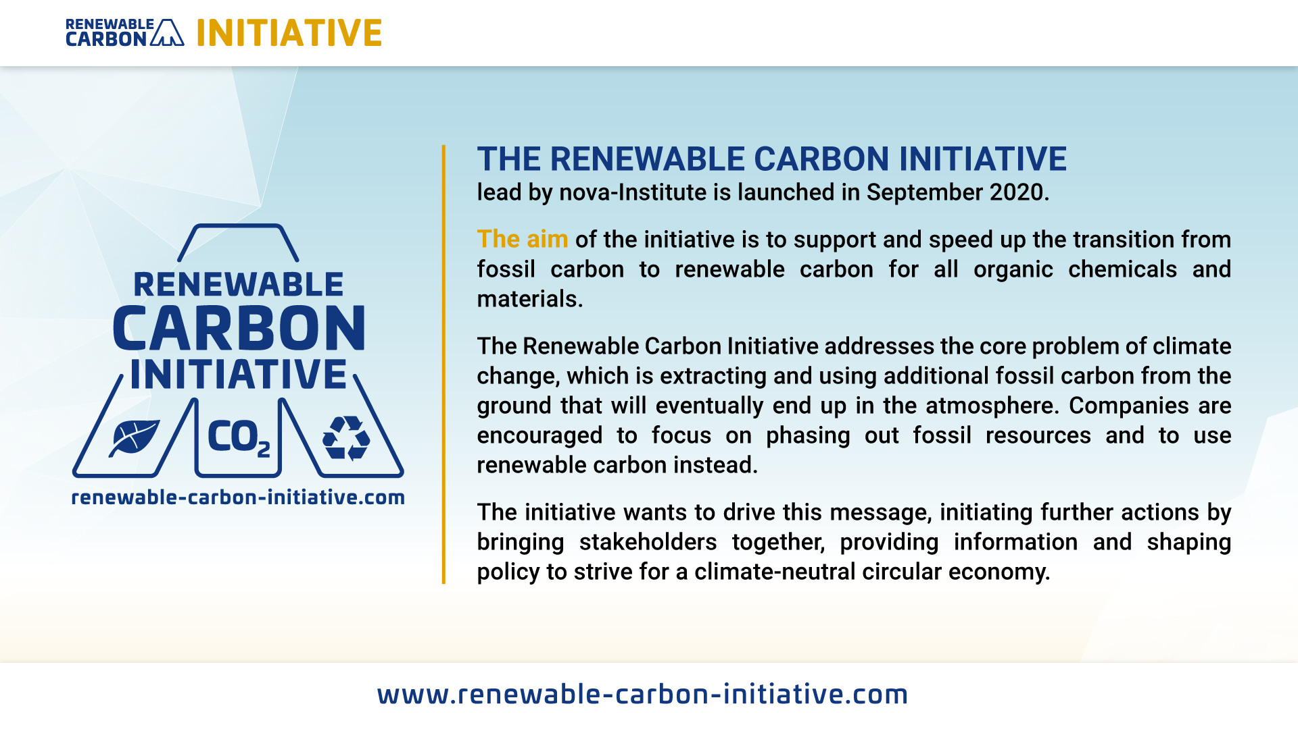

Slide 23
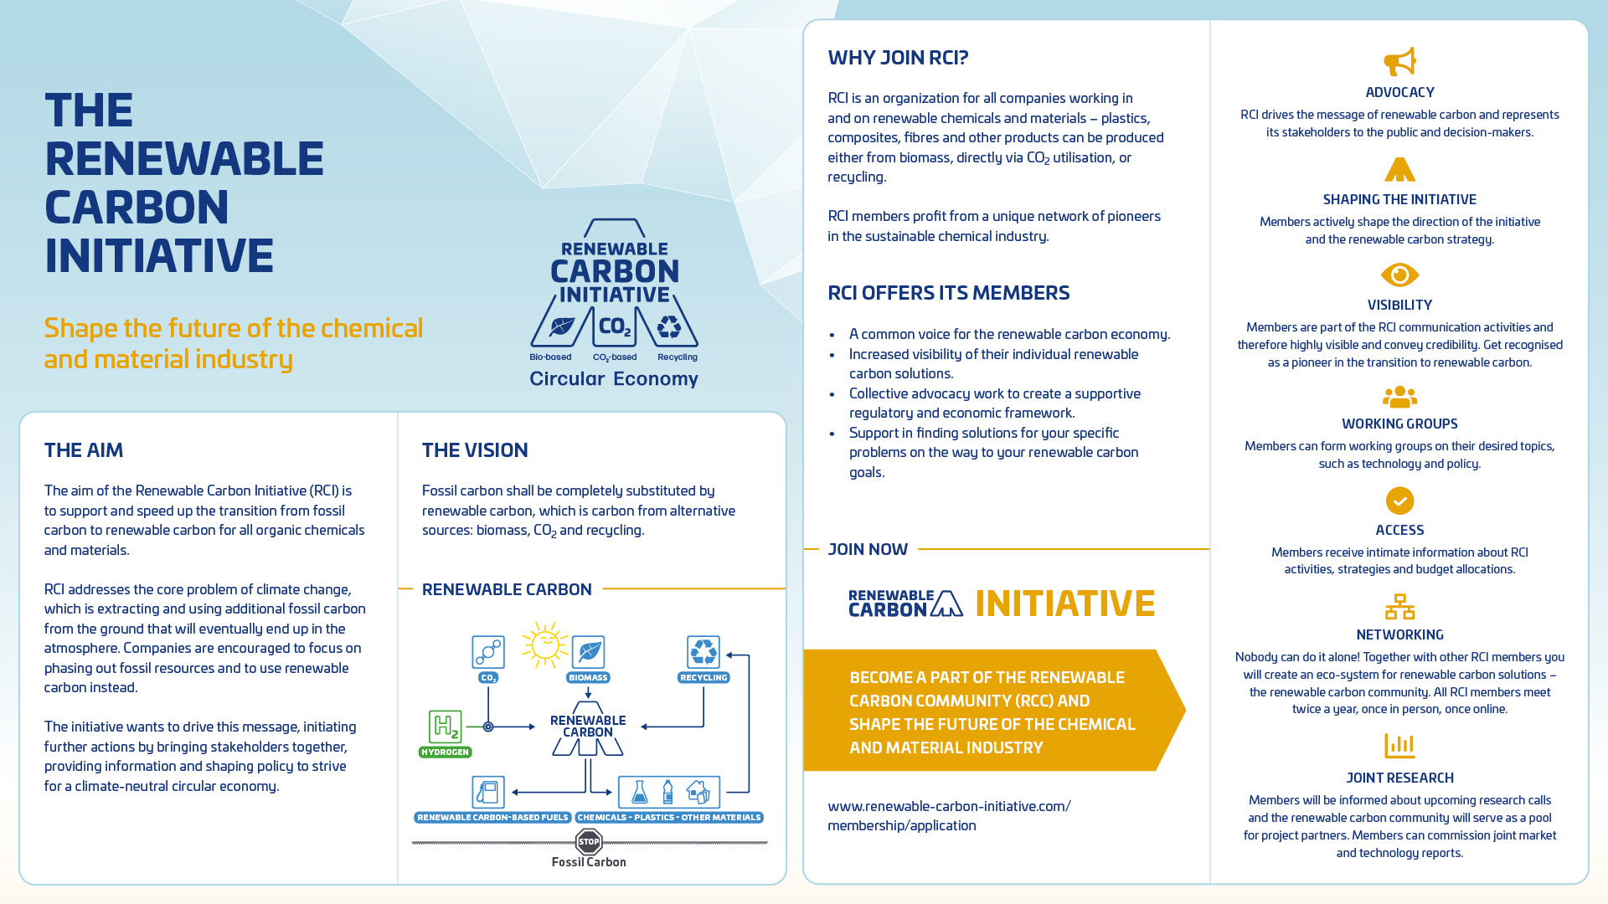

Slide 24
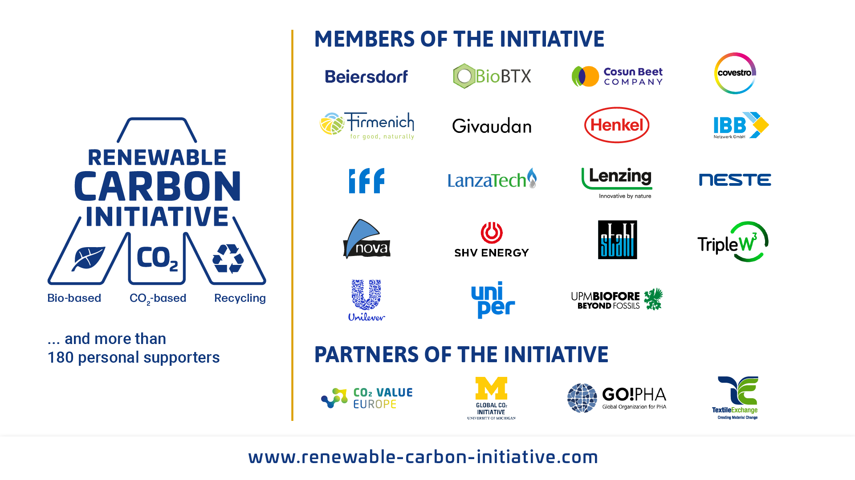

Slide 25

Save the Date
All conferences at www.bio-based.eu
Contact: Mr. Dominik Vogt, +49 (0) 2233 48 14 49, Dominik.vogt@nova-institut.de

Slide 26
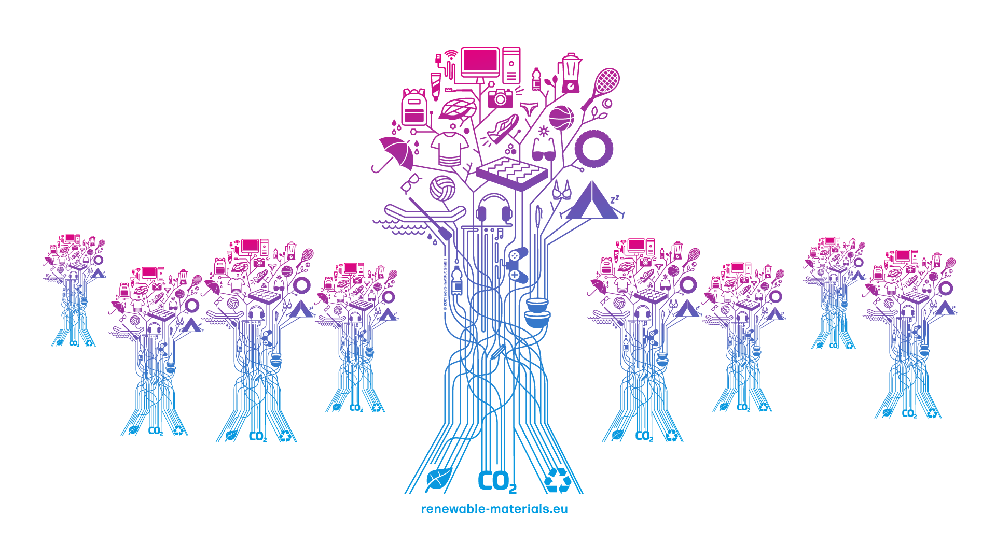
The Renewable Material Tree

Slide 27




Thank you for your attention!
Dipl.-Phys. Michael Carus
+49 (0) 2233 48 14-40
michael.carus@nova-institut.de
Bio-based economy
Markets & marketing
Sustainability & policy

